Slide 1
Cloud Semantics.org
Tom Bascom
tom@LinkSpace.net
LinkSpace, LLC Proprietary and Confidential
© 2014, all rights reserved

Slide 2


The Standardization Payoff
Custom Integration model: What System Integrators do
Federation Model: What Users can do with Interoperable Resources
The Key is Agreement
LinkSpace, LLC Proprietary and Confidential
© 2014, all rights reserved

Slide 3




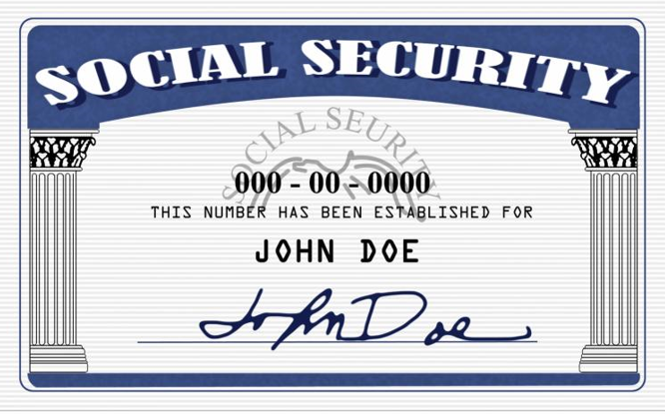

Standards [ Standards (Standards)]
1
JSON
2
Practitioners
XML
Meaning
Industry Standards
Identifiers
Master Data Standards
Expression
Technology Standards
Developers
Successful interoperability will be decided by the developer community’s adoption, interpretation and implementation of standards
LinkSpace, LLC Proprietary and Confidential
© 2014, all rights reserved

Slide 4

Interoperability Negotiation Process
Coordination
Industry Standards
Interpretation
FHIR
ASC X12
Technology Standards
Interpretation
UML
XSD
OWL
GS1
JSON
NIST
STIX-TAXII
...
…
Integration
Parties Must Coordinate Their Independent Interpretations In Order To Integrate
LinkSpace, LLC Proprietary and Confidential
© 2014, all rights reserved

Slide 5

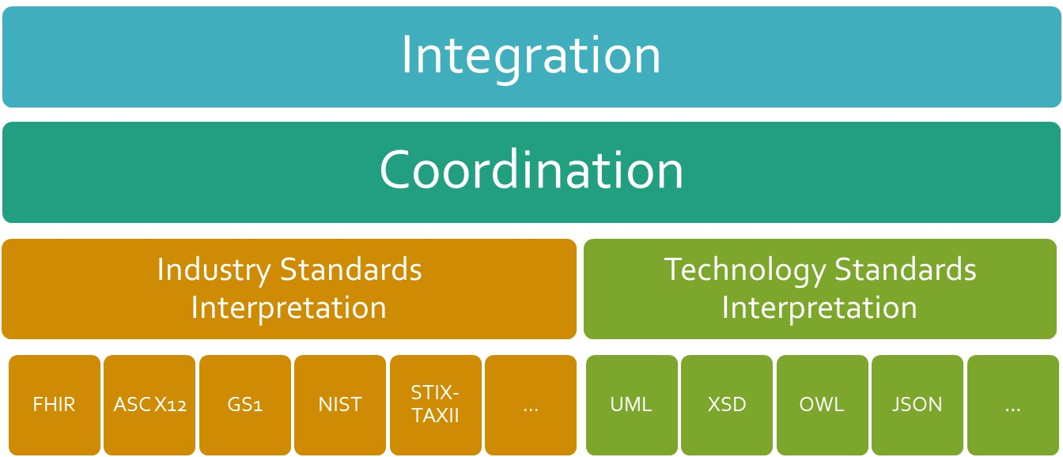
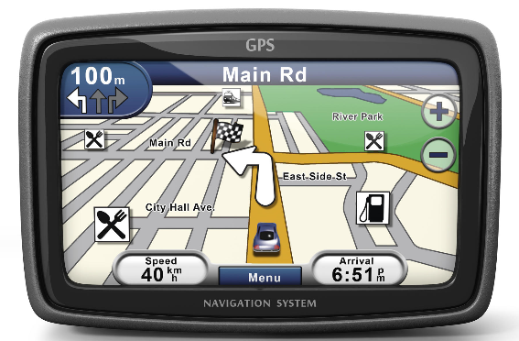

The Reference Registry Model
Coordination through a CloudSemantics.org Registry
Data Exchange Standards
Interpretation
NIEM
ASC X12
Technology Standards
Interpretation
UML
XSD
OWL
GS1
JSON
NIST
STIX-TAXII
...
…
Registration and Alignment
Independent Interpretations
LinkSpace, LLC Proprietary and Confidential
© 2014, all rights reserved

Slide 6
Backup

Slide 7
Agreement Through Industry Standards (Goal)
Industry Standard
Without Standards:
Labor intensive point-to-point coordination
With Standards:
Automated interoperability through shared interpretation
Tool
Automated Interoperability Through Industry Standards
Data
Tool
Data
Tool
Data
Tool
Data
Tool
Industry Standard
Data
Goal: Automated interoperability
LinkSpace, LLC Proprietary and Confidential
© 2014, all rights reserved

Slide 8
Agreement Through Industry Standards (Reality)
Industry Standard
With Standards (Reality):
Independent interpretations of Industry Standards, often published in prose, prevent automation of interoperability
Tool
Negotiated Interoperability
Data
Tool
Data
Tool
Data
Tool
Data
Tool
Industry Standard
Data
Reality: Point to point, negotiated interoperability
LinkSpace, LLC Proprietary and Confidential
© 2014, all rights reserved

Slide 9
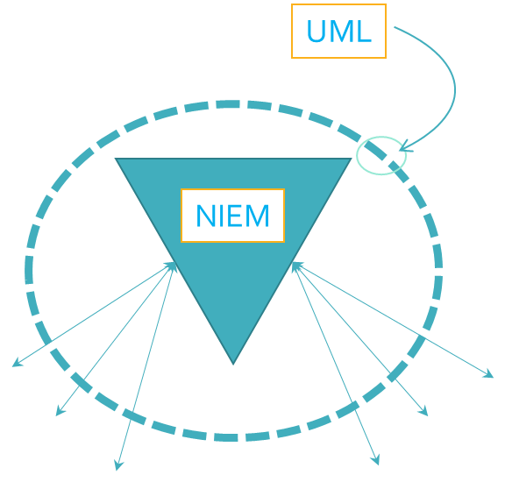
Challenges of Agreement Through Standards (Summary)
Interpretation: Standards are written by committee,
intentionally broad, and interpreted and implemented independently.
Format: Industry standards bodies often publish in only one Technology Standard format.
Coordination: The knowledge of the differences among various expressions, interpretations, implementations is not captured anywhere nor accessible during sharing and integration.
Versioning: Archived data, expressed in historical standards, remain isolated from integration with modern implementations.
LinkSpace, LLC Proprietary and Confidential
© 2014, all rights reserved

Slide 10
Costs of Poorly Implemented Standards
Variety:
  High cost to Rationalize and integrate information from
  multiple interpretations of even the same models
Architectural Complexity:
  High cost of maintaining multiple adapters and transformations to overcome incompatible interpretations and variety of expressions.
Rework and Relearning:
  High cost and delays from forensic work required to maintain and integrate poorly documented, incompatible data and software
Inaccessible data:
  High cost and delays to incorporate external or Archived data.
Inflexibility:
  High cost and delays to implement changes in the Standards
LinkSpace, LLC Proprietary and Confidential
© 2014, all rights reserved

Slide 11
The CloudSemantics.org Approach
Industry Standard interpretations accessible using a variety of Technology Standards
A Registry of Industry, Technology and
Standards
  Capture coordinated interpretations
  Capture Independent interpretations and Versions
  Capture Alignments among the interpretations
  Publish coordinated interpretations and alignments
CloudSemantics.org
Common Registry
Tool
Semantic Interoperability through a Standards Registry
Data
Tool
Data
Tool
Data
Tool
Data
Tool
Data
Automated Agreement at the speed and scale of the Internet
LinkSpace, LLC Proprietary and Confidential
© 2014, all rights reserved

Slide 12



Master Data Registry
Keys
  Information systems use universal identifiers, or “keys”, to label records associated with the unique identifier
    Bar codes – Unique product identifiers
    Social Security Numbers – Unique person identifiers
    Legal Entity Identifier – Unique business identifiers
Master Data
  Distributed applications that rely on a shared,
  Master Data store, of “Keys” can assure their
  data can be appropriately merged and records
  aligned by matching keys.
The Master Data Registry
  The Semantic Registry puts CloudSemantics.org in a unique position to host a Master Data Registry with unique identifiers aligned with the managed Industry Standards.
LinkSpace, LLC Proprietary and Confidential
© 2014, all rights reserved

Slide 13
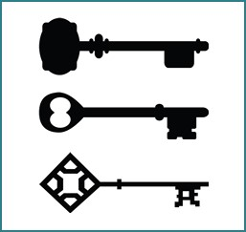
CloudSemantics.org
A common registry of
  Industry Standards
  Technology Standards
  Master Data
Tool
Semantic Interoperability through Registries
Data
Tool
Data
Tool
Data
Tool
Data
Tool
Data
Automated Agreement and Integration at the speed and scale of the Internet
LinkSpace, LLC Proprietary and Confidential
© 2014, all rights reserved

